Slide 1
Portuguese Wine Quality
Abby Lavoie
Dec 8, 2022

Slide 2
Agenda
Introduction to the dataset
Context
Structure
Visualization
Model Building
Data cleaning/Processing
Feature Selection
Methods
Performance comparison
Limitations
Future Direction

Slide 3


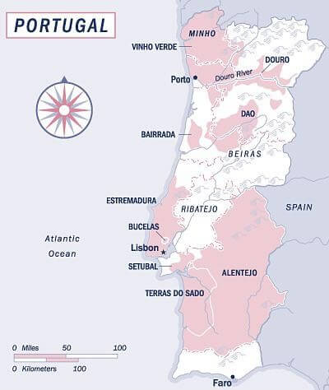
Introduction
Context:
Vinho Verde Wines
White, red, rosé
Minho Region – Portugal
Exported
Motivation:
Live nearby vineyards
Interest in Chemistry & Perception
Preprocessed

Slide 4
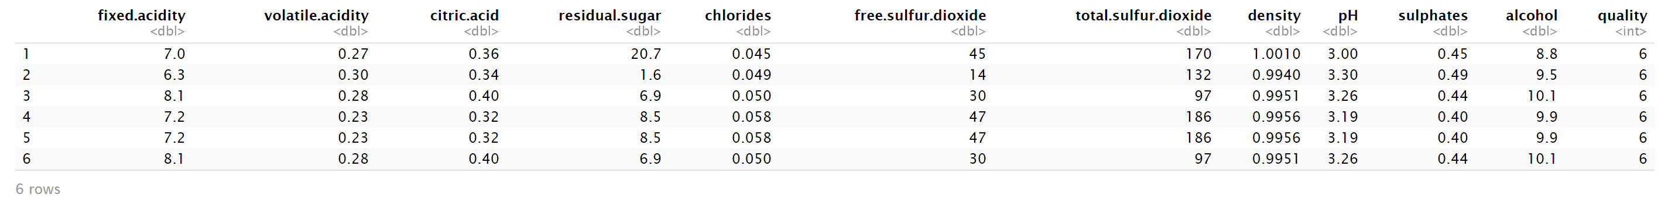
The Dataset: Variables
4898 samples, 11 predictors, 1 response
White Vinho Verde Wines
Predictors: physiochemical Measures (selected from larger set)
Fixed Acidity, Volatile Acidity, Citric Acid, Residual Sugar, Chlorides, free sulfur dioxide, total sulfur dioxide, density, pH, sulphates, and alcohol

Slide 5
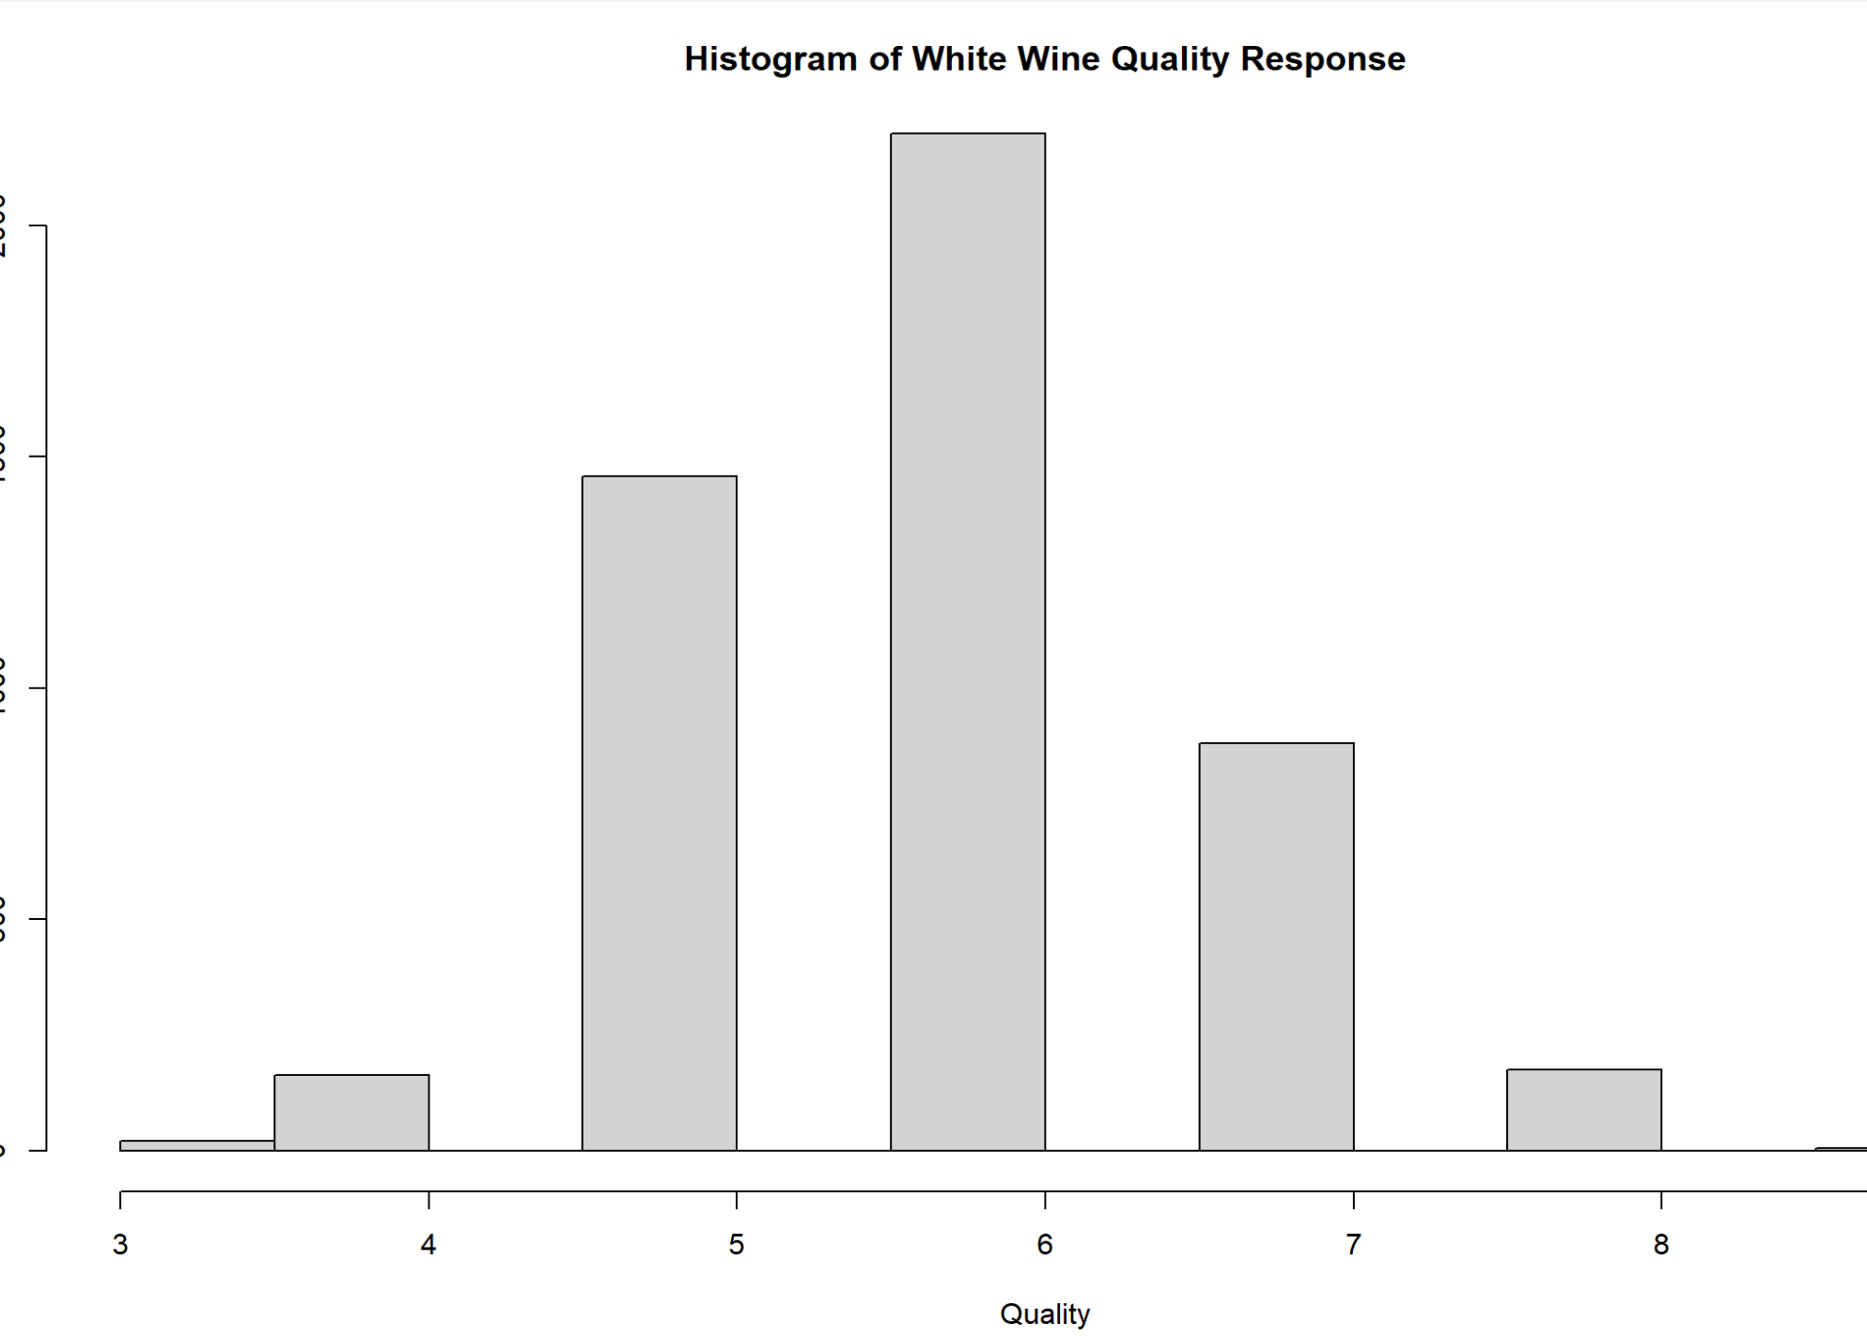
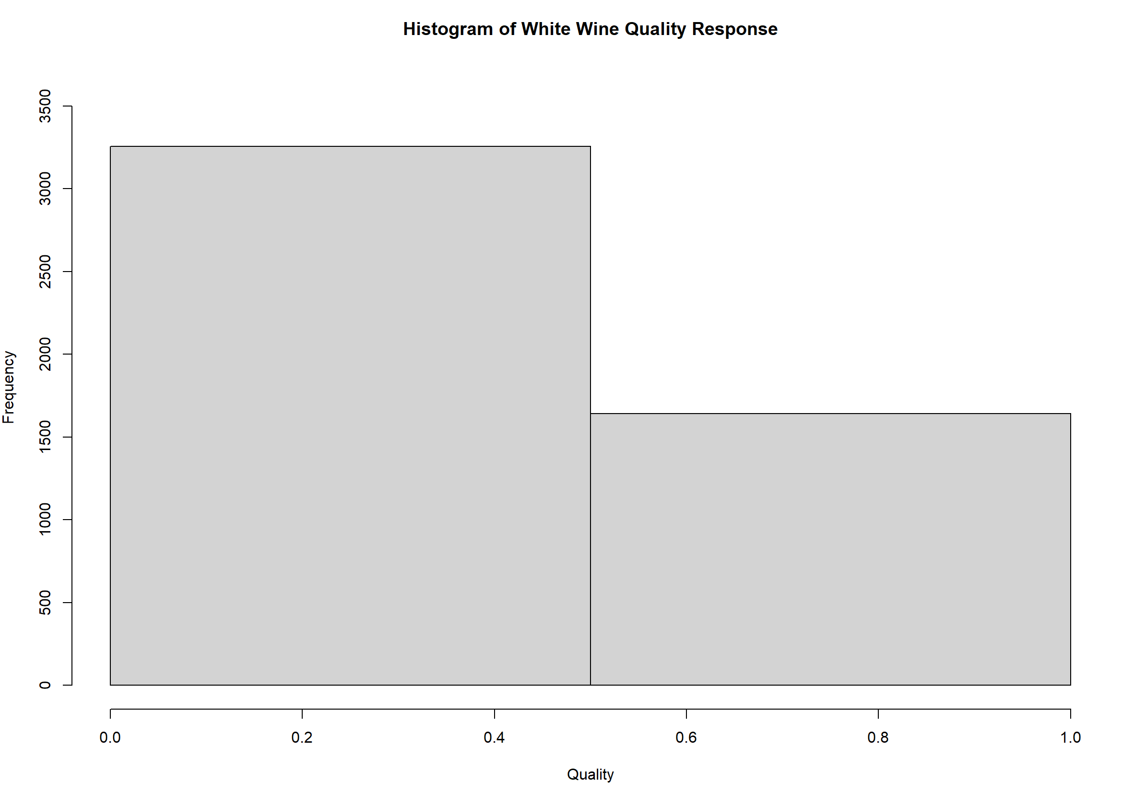
The DataSet: Response
Response: Ranking of quality
3+ expert tasters, median value
0 (bad) to 10 (excellent), but only 3 to 9
Changed to Binary -> Good (6+), Poor (5-)
Not balanced
3:4:5:6:7:8:9 = 20:163:1457:2198:880:175:5
Good:poor = 3258:1640

Slide 6

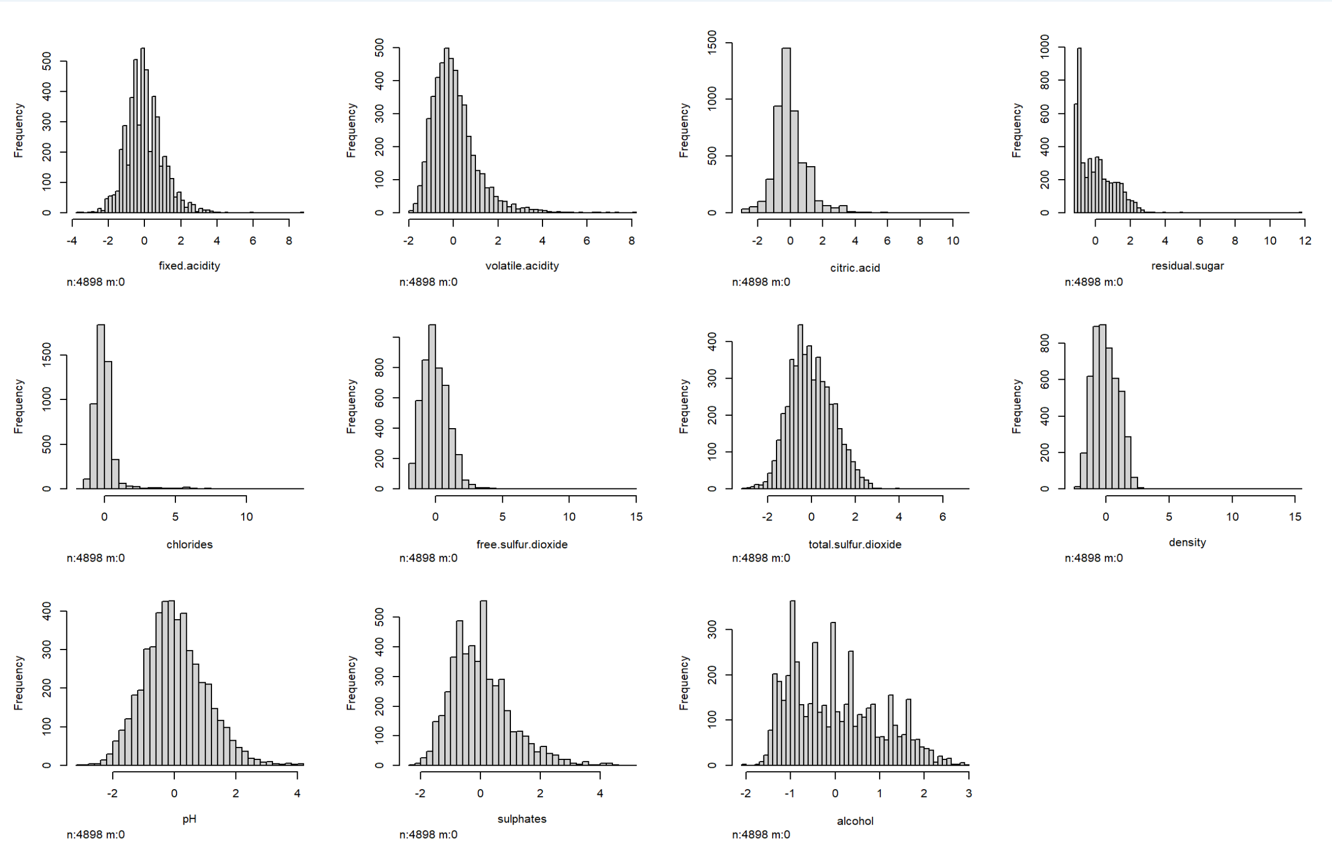
Data: predictors

Slide 7
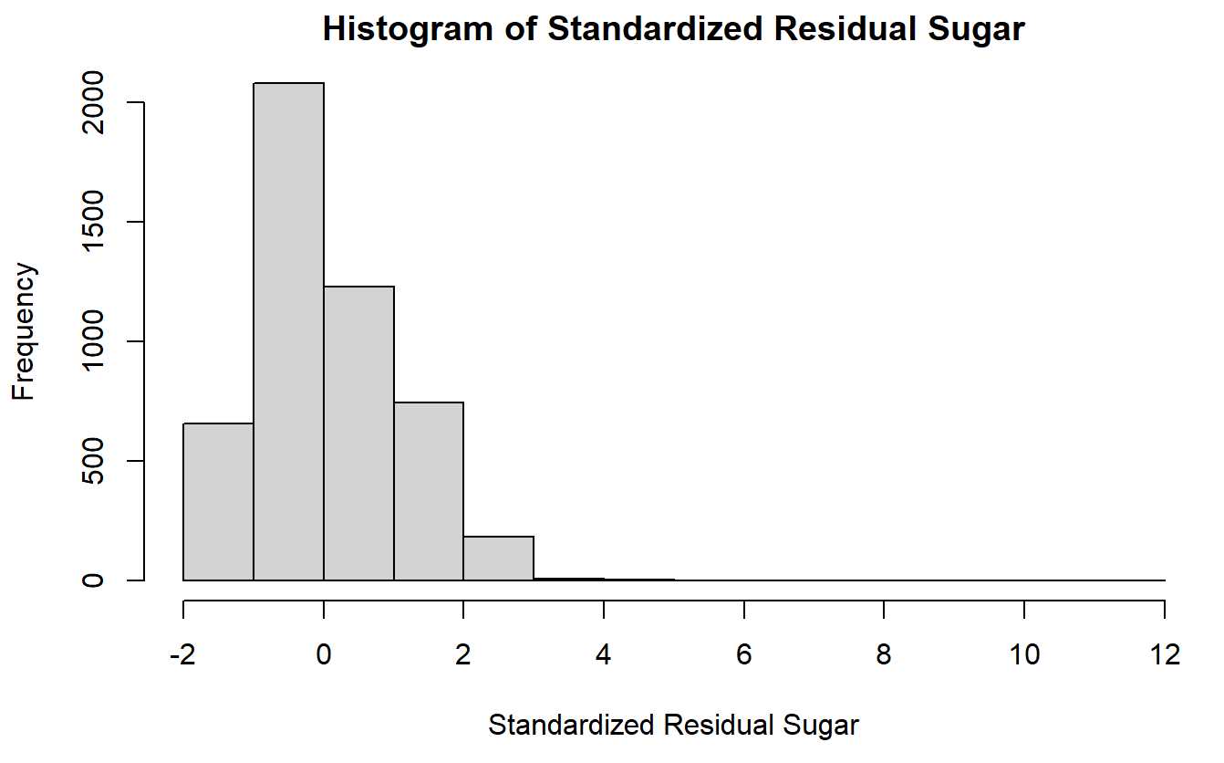
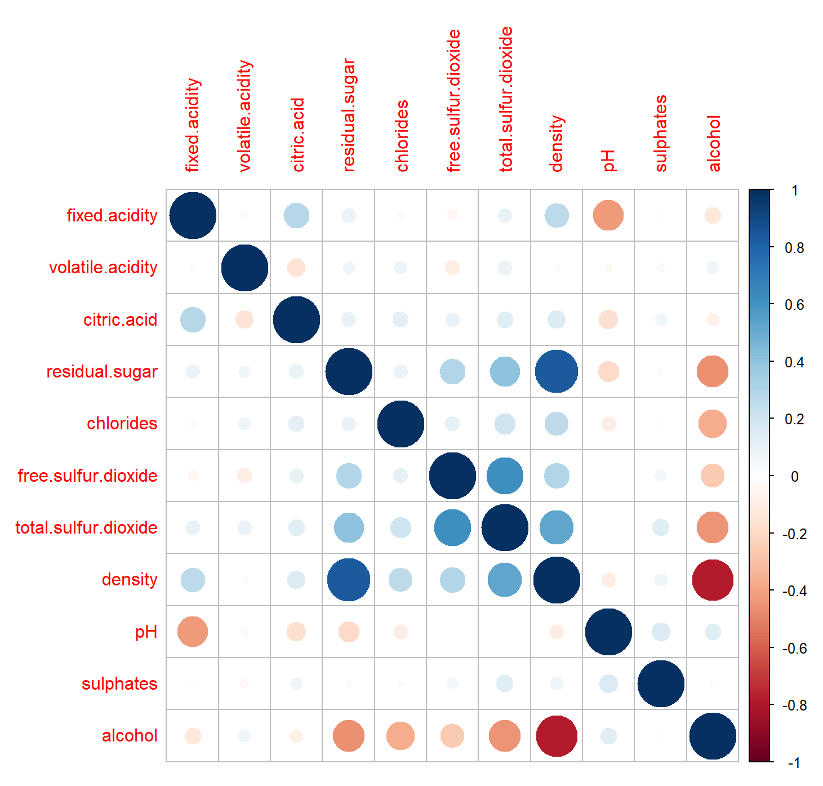
Data Processing
0 NA’s
Variance >0
Standardized Variables
Correlations
Dropped Density
(Based on prior research, density was not in top 7 vars)
Now 10 predictors

Slide 8
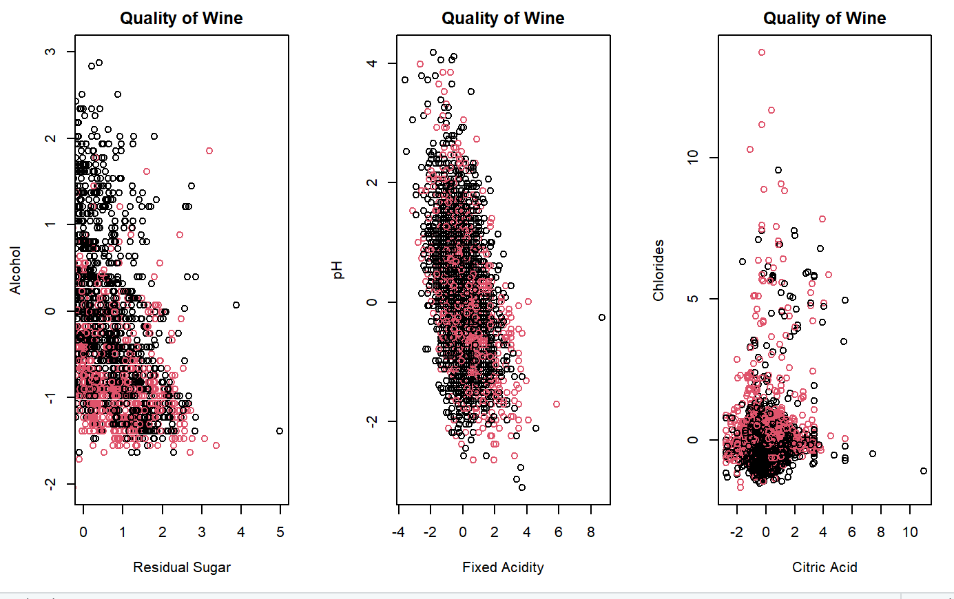
Data Visualization
Red = “Poor” quality
Black = “Good” Quality

Slide 9
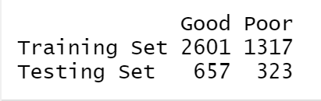
Data split
Train – 80%, Test – 20%
Randomly split
Train = 3918 observations
Test = 980 observations
Outcome proportions maintained

Slide 10
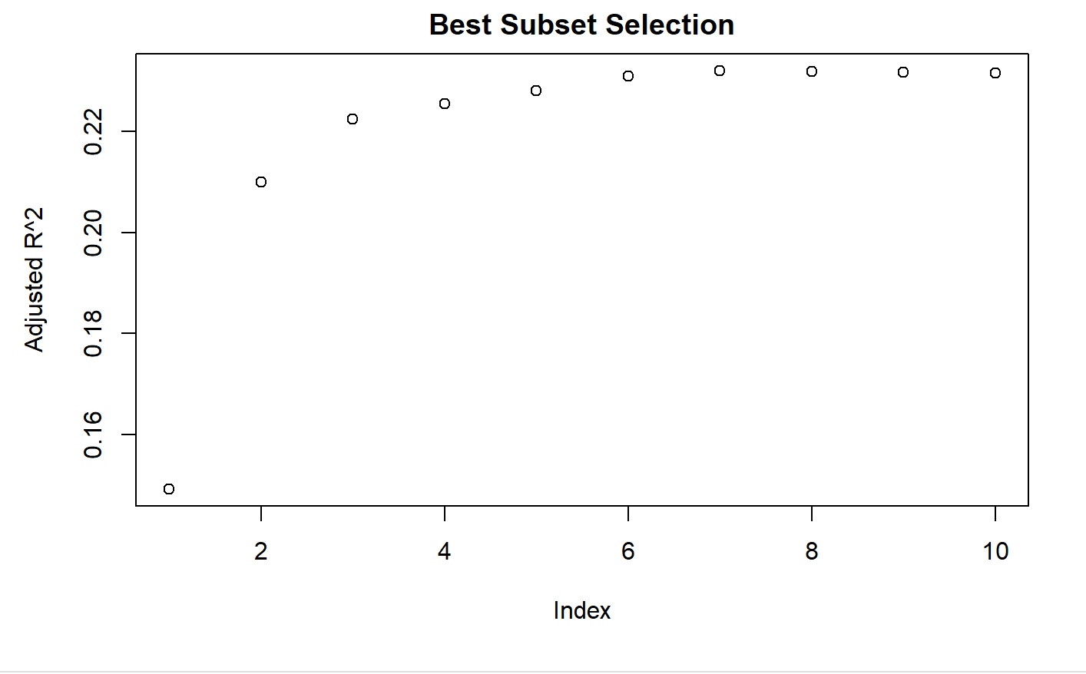
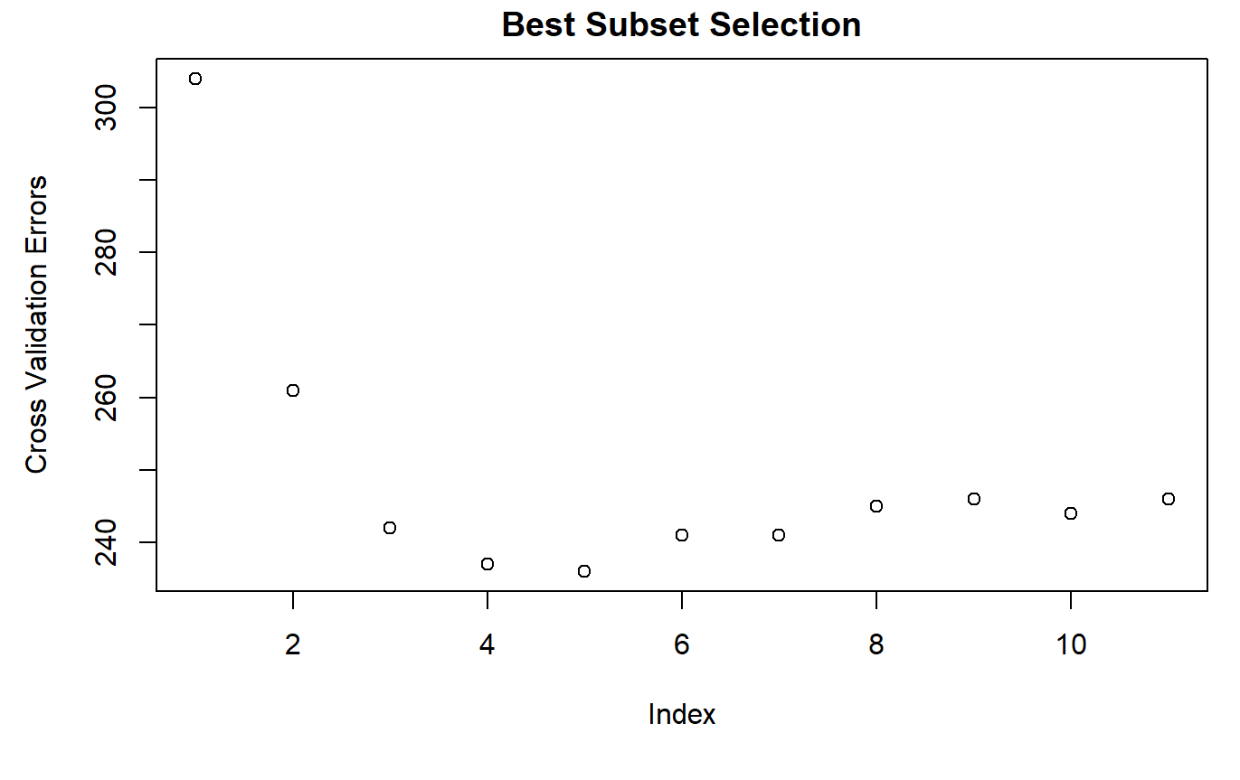
Feature Selection
CV: 5-variable model Best
25 fewer errors for 5-variable model than 2-variable
Used both Best 2- and best 5- variable choices
2: Alcohol + Volatile Acidity
5: Alcohol, Volatile Acidity, Residual Sugar, sulphates, and fixed acidity

Slide 11
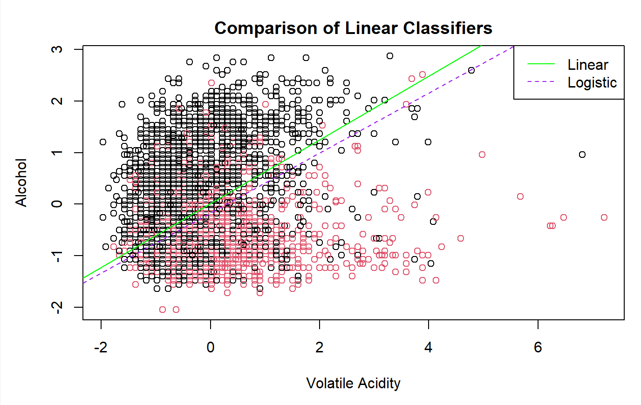
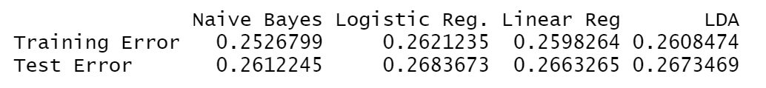
Comparison of Linear Classifiers
Naïve Bayes, Logistic Regression, Linear Regression, and Linear Discriminant Analysis (LDA)
2-predictor Error

Slide 12
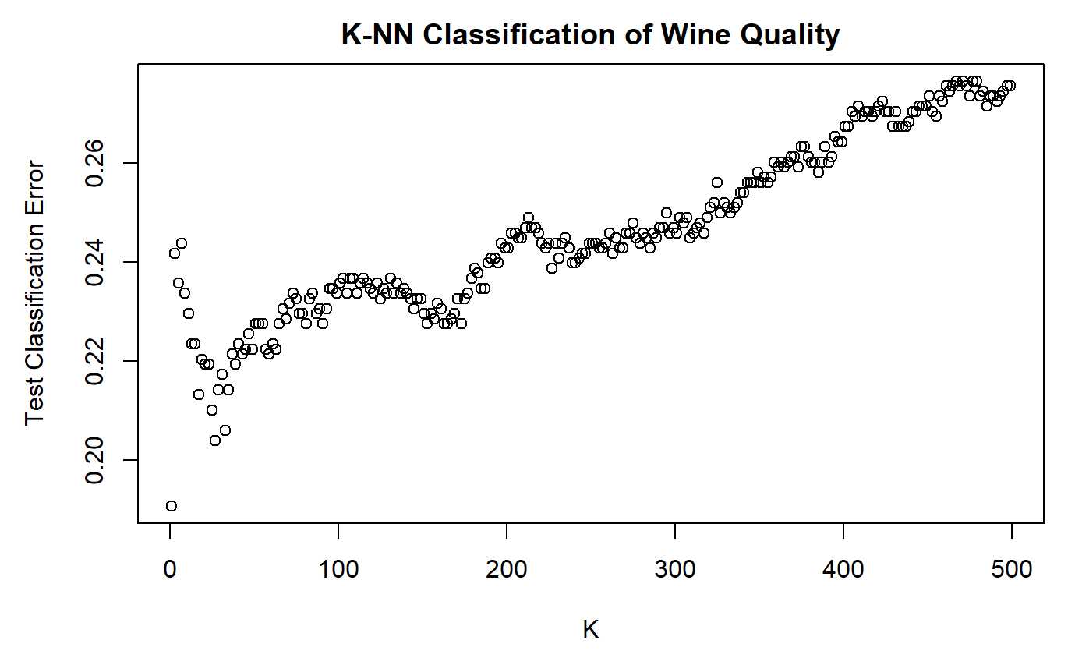
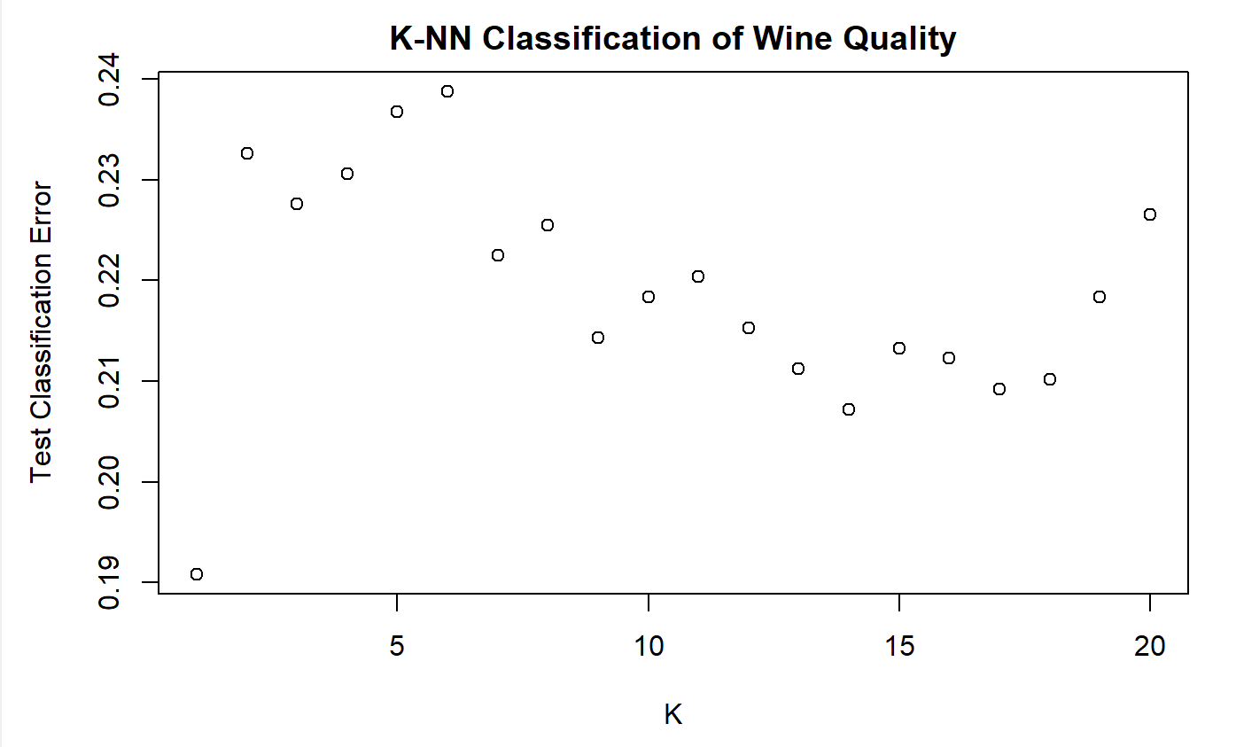
KNN Classification

Slide 13
SVM Classification
Linear
Polynomial
Radial
Test Error: 0.2469388
Cost: 0.1
Support vectors: 2298
Degree = 2
Test Error: 0.3040816
Cost: 1
Support vectors: 2511
Degree = 3
Test Error: 0.2673469
Cost:1
Support vectors: 2234
Test Error: 0.1897959
Cost: 1
Support vectors: 2599

Slide 14
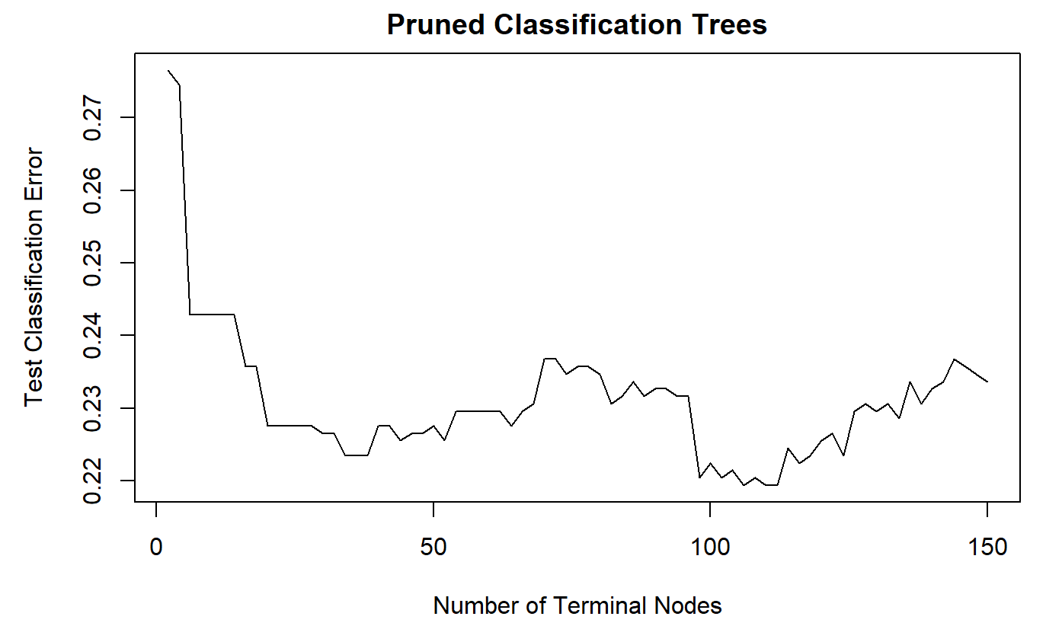
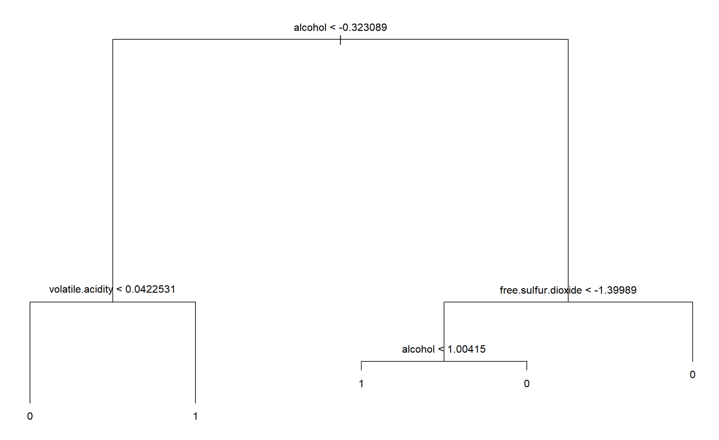
Classification Tree
Unpruned Tree
Test Error: 0.2428571
Best CV-Pruned Tree
Terminal nodes: 106
Test error: 0.2193878

Slide 15
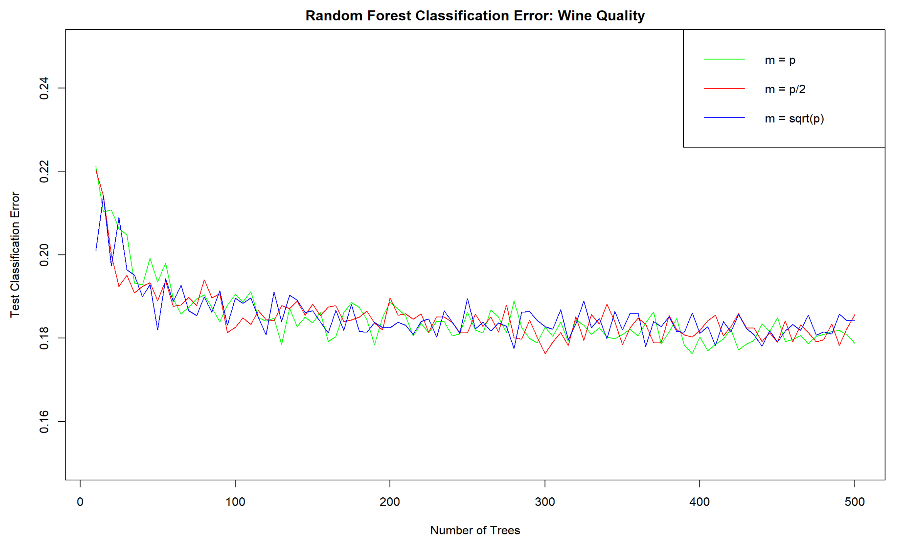
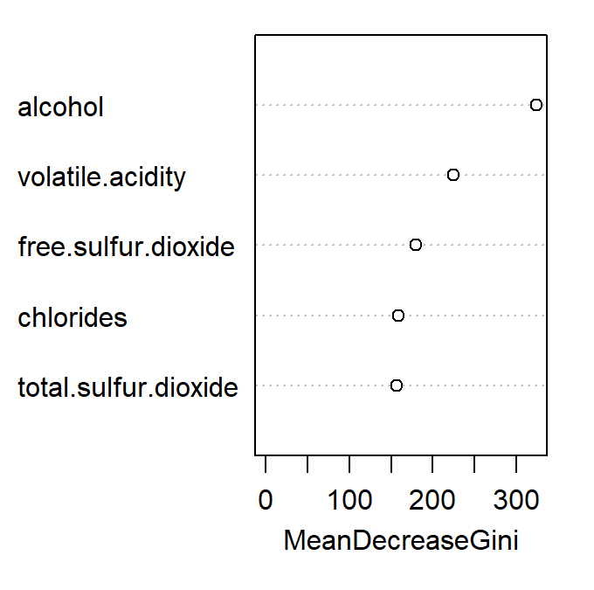
Random Forest

Slide 16
Conclusions
Test Error
Important Variables
Best Linear Classifier: 0.2408163
5-predictor model
Best KNN: 0.1908163 (next best: 0.2040816)
K=0 (K=14)
Best SVM: 0.1897959
Radial kernel, cost =1
Best Classification Tree: 0.2193878
106 terminal nodes
Best Random Forest: 0.1763064
M=p/2, 300 trees
Alcohol
Volatile Acidity
Residual Sugar (FS), Free sulfur dioxide (tree, RF)
Sulphates (FS), chlorides(RF)

Slide 17
Limitations and the Future
Imbalanced data
Add a cost to classification
DownSampling
Treated as 2 class
Multi-Class Classification
Retain 3 to 9
Re-stratify into bad, mediocre, good
Fresher data
Relate to consumer tastes/Preferences
Expand to other wines

Slide 18
References
P. Cortez, A. Cerdeira, F. Almeida, T. Matos and J. Reis. Modeling wine preferences by data mining from physicochemical properties. In Decision Support Systems, Elsevier, 47(4):547-553, 2009.
Image taken from: https://www.extension.iastate.edu/wine/regional-focus-portugals-vinho-verde-minho/

